Slide 1
Microservices with Docker, .NET Core and Azure
A beautiful journey by Piotr Włodek

Slide 2
Agenda
Docker Recap
Microservices
Swarm Mode
Hosting on Azure

Slide 3
Quick docker recap
Images
Containers
Services
Stacks
Registry
docker run –p 8080:80 image_name
docker-compose –f docker-compose.yml build/up/down
docker stack deploy –c docker-compose.yml my_app_name
Notes:
docker image inspect
screen ~/Library/Containers/com.docker.docker/Data/com.docker.driver.amd64-linux/tty
Inspect /var/lib/docker/overlay2

Slide 4
Images and containers

Slide 5
Monolith

Slide 6
Microservices

Slide 7
Monolith Pros and Cons
Easy to understand
Easy to develop
Fast calls between components
Single deployment
Good for larger teams
Tight coupling between layers
No independent scaling
Single change requires testing the whole system
Single technology

Slide 8
Microservices Pros and Cons
Loose coupling between services
Independent component scaling and development
Rich tech stack
Single change requires testing of the containing service
Better for larger numer of smaller teams
More complex architecture
Harder to develop and maintain
Eventual consistency
More complex deployments

Slide 9
Scaling

Slide 10
Sample Solution - Technology
SQL Server 2017 for Linux
Rabbit MQ
MassTransit
Dapper
EntityFramework Core
ASP.NET Core

Slide 11
Sample Solution - Overview

Slide 12
Sample Solution - Flow

Slide 13
Communication
Asynchronous
Queues, abstractions like MassTransit, NServiceBus
Commands VS Events
Synchronous HTTP
Should be external to microservices

Slide 16
DEMO
Notes:
Run entire thing on a local Docker in swarm mode
Show infrastructure project

Slide 17
Sample Solution – Key Points
SOA done right
Asynchronous communication accross services (Queues)
Data passed as id’s, not the data itself
Data is distributed, need to embrace eventual consistency
API Gateway
Read tables
Synchronous data requests (HTTP, Load balancing)
Avoid chaining services with HTTP (not a microservice architecture)
Saga for process management

Slide 18
API Gateway
Data aggregation
Hides internal implementation (like port mapping)
Azure API Management
Additional microservices

Slide 19
Container Hosting on Azure
Azure Container Instances (preview)
Web App for Containers
Azure Container Services (ACS) <- No Swarm Mode (!!!)
Azure Container Services for Kubernetes Preview (AKS)
ACS-Engine – community app for generating azure templates
https://azure.microsoft.com/en-us/resources/templates/101-acsengine-swarmmode/
Manual cluster

Slide 20
ACS Engine Architecture

Slide 21
Modern datacenter

Slide 22
Availability Set

Slide 23
Scale Set

Slide 24
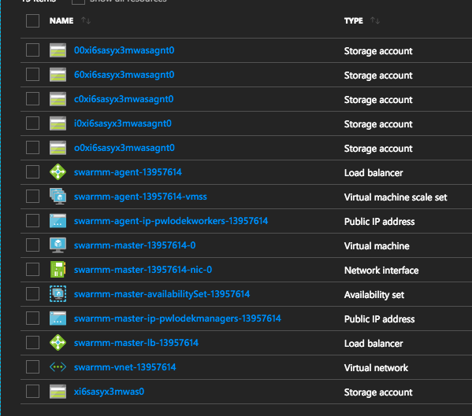
Creating production Docker Swarm cluster

Slide 25
Creating SSH tunnel
How to authenticate from master node to worker node using ssh key?
Create ~/.ssh/config
Host *
ForwardAgent yes
ssh-add -K ~/.ssh/id_rsa

Slide 26
References
https://docs.microsoft.com/en-us/azure/architecture/guide/architecture-styles/microservices
https://docs.microsoft.com/en-us/azure/service-fabric/service-fabric-overview-microservices
https://docs.microsoft.com/en-us/azure/container-service/dcos-swarm/container-service-intro
https://github.com/Azure/acs-engine/blob/master/docs/swarmmode.md

